Slide 1

Tertiary Supports:
Social Skills Instruction

Slide 2

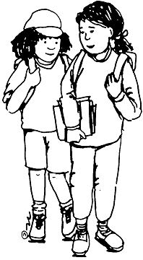
Social Skills Defined
Social Skills: “reciprocal process in which children effectively initiate and respond to social stimuli presented by their peers” (Shores, 1987)
Social Interaction: “the reciprocal exchange of social behavior between or among two or more children.” (Brown, Odom, & Holcombe, 1996)

Slide 3
Social Skills Deficits
Acquisition
“cant do”
Doesn’t know how
Performance
“won’t do”
Familiar with skill

Slide 4
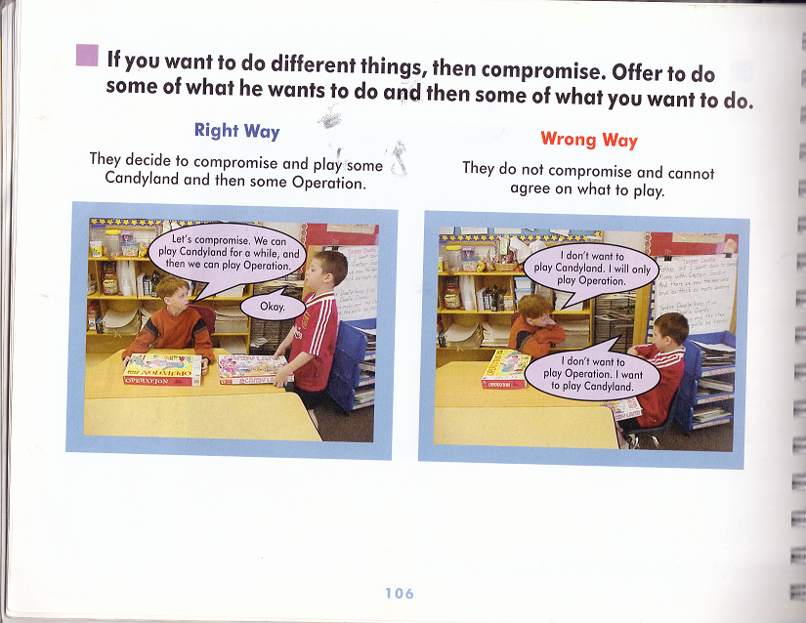

Slide 5
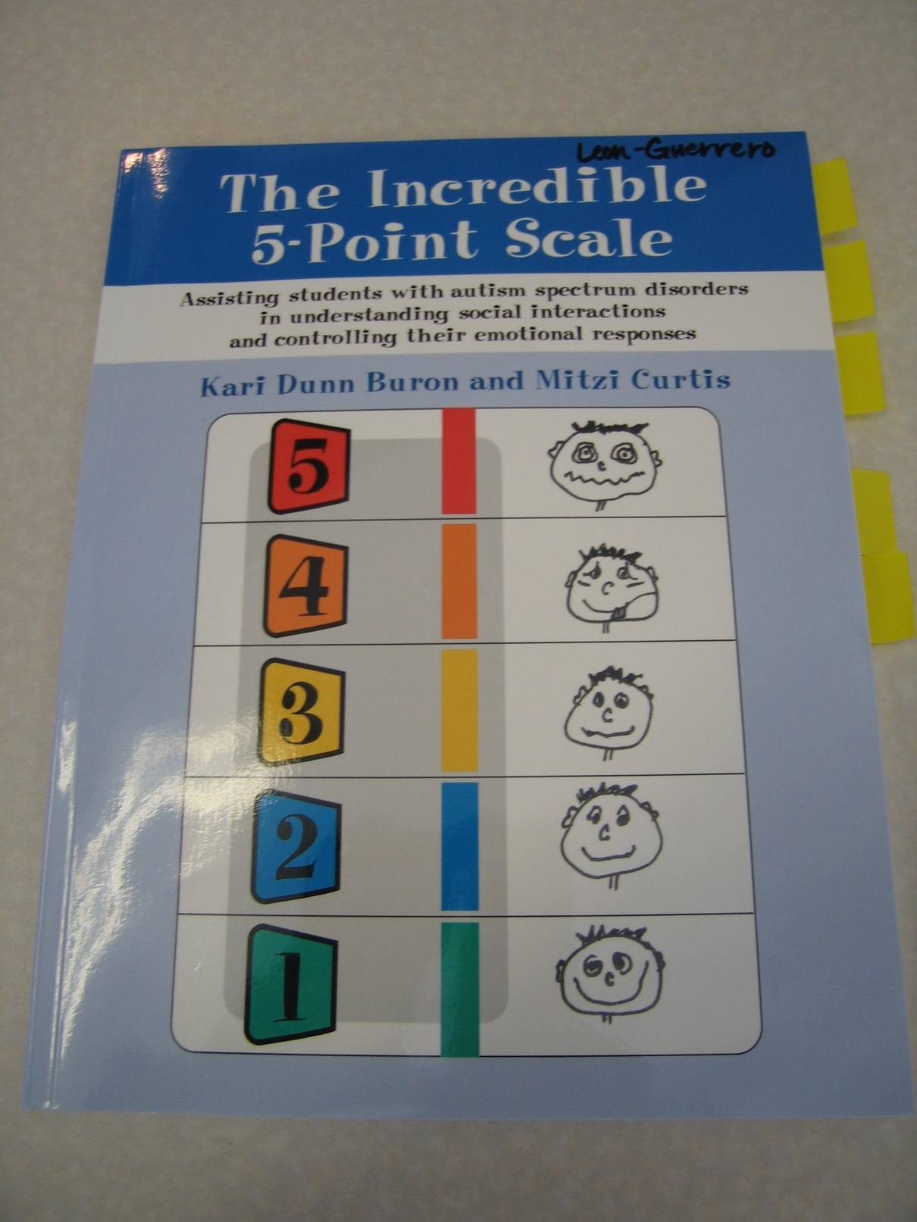

Slide 6
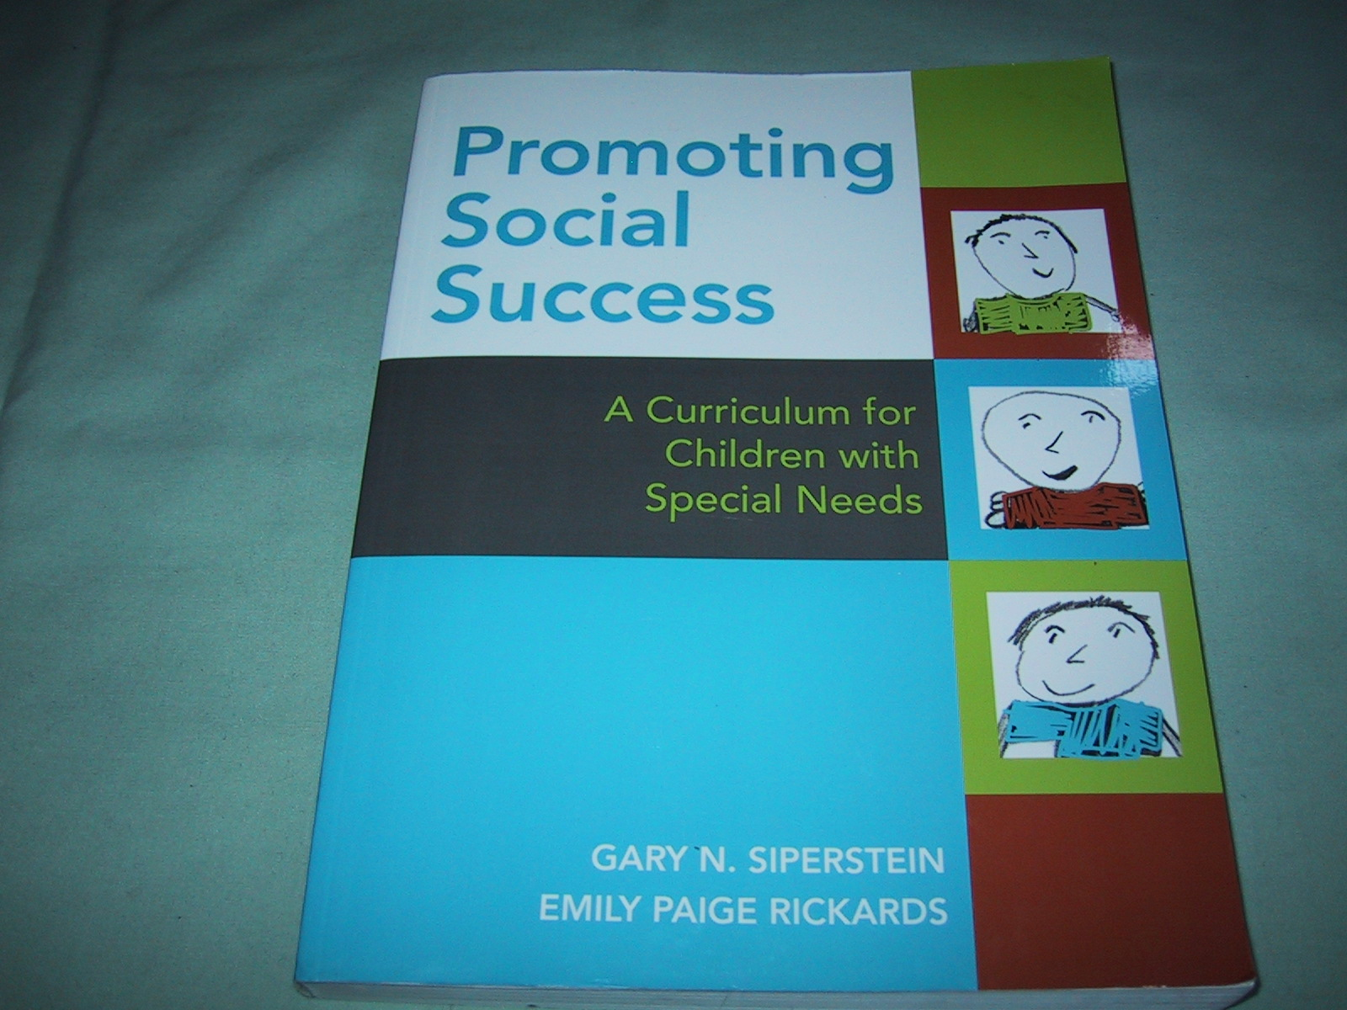

Slide 7


Slide 8
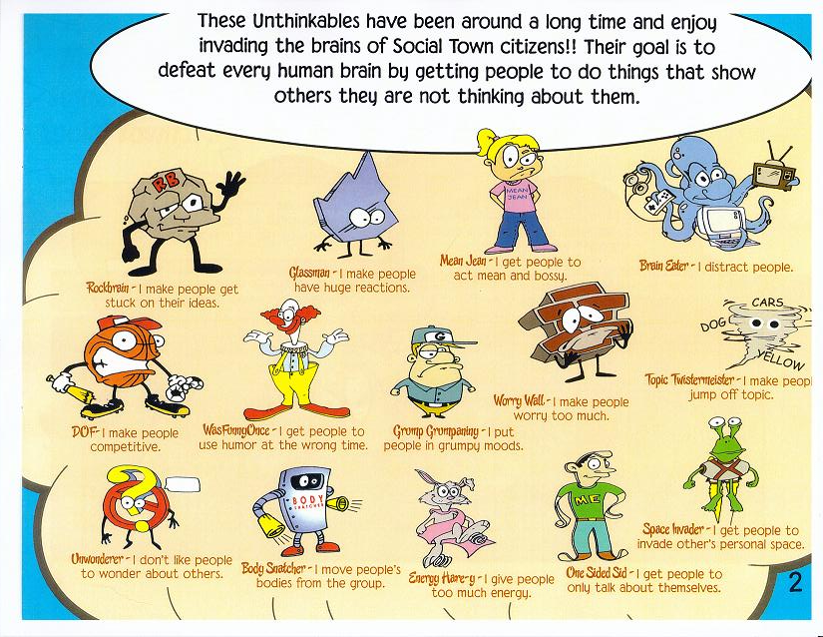

Slide 9
Teaching Strategies

Slide 10
General Conclusions from Research
Some form of teaching is necessary
Specific reinforcement procedures are required to encourage interaction

Slide 11
Explicit Instruction: Why is it useful for teaching social skills?
Breaks down complex skills into smaller parts
Allows for practice in neutral settings

Slide 12
Explicit Instruction: Structured Learning
What is it?
A model that uses 4 steps

Slide 13
How to use structured learning
Introduce new skill
Large group or small group
Examples and non examples
Visual of skill
Modeling
Adult models the behavior
Practice in planned activity and across other activities/ settings
Role Play

Slide 14
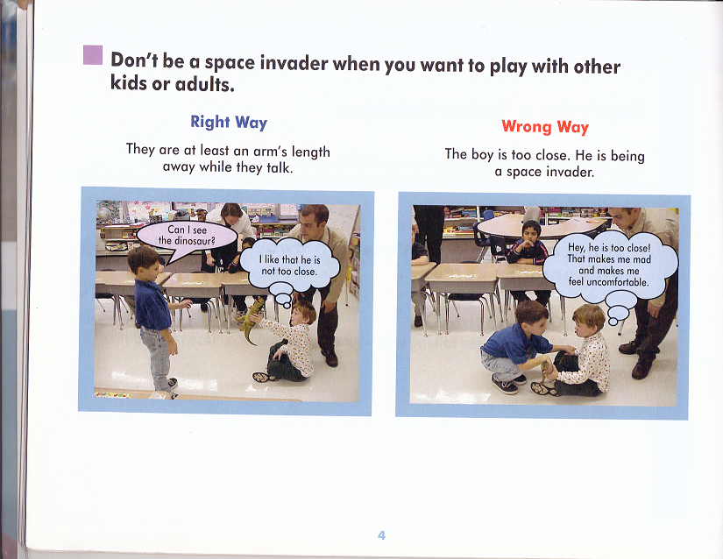

Slide 15
A strategy that really works….
Verbal info
Visual Supports

Slide 16
Visual Based Strategies: Why are they useful for teaching social skills?
Static information
Serves as cue to initiate behavior

Slide 17
General Guidelines for Visuals
Does a visual strategy need to exist for a student to participate?
Will the student understand the visual?
How will you teach the student to use the visual?

Slide 18
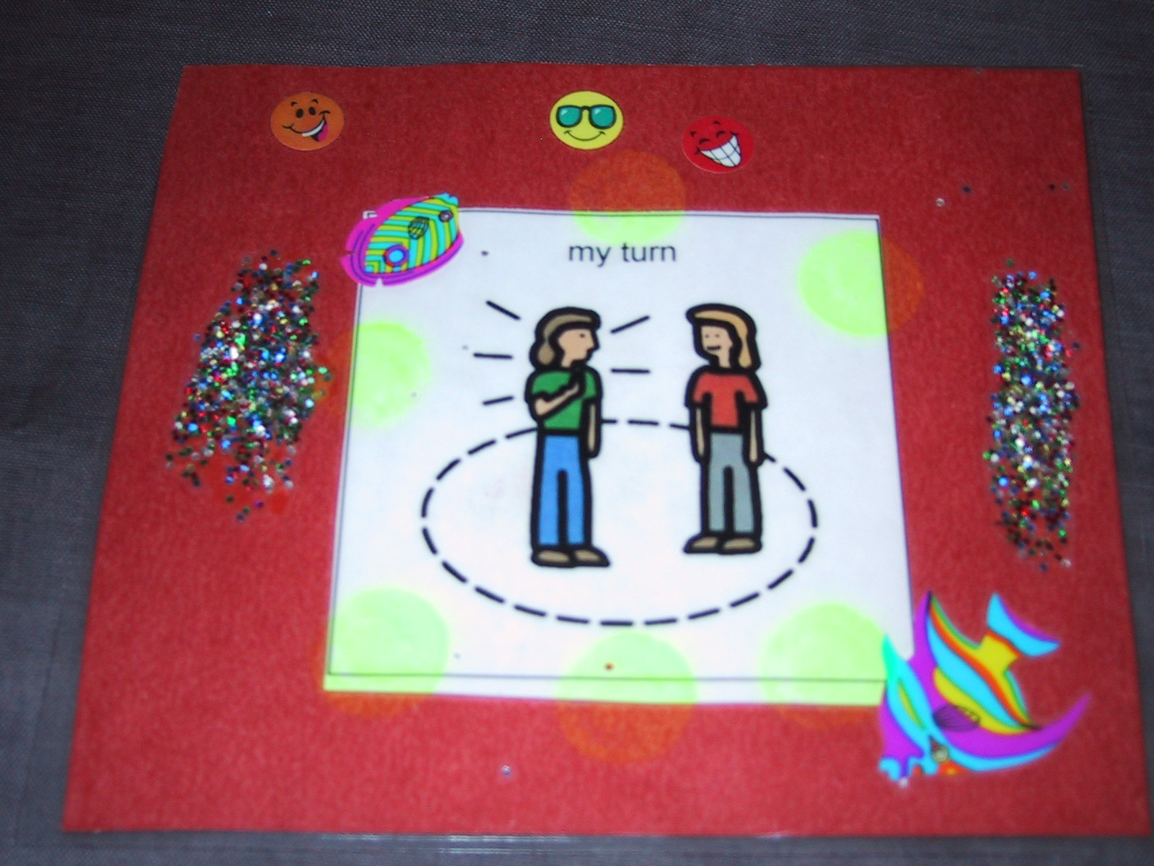

Slide 19
Visual Based Strategies: Social Stories or Scripts
What are they?
Provide info about expected behavior
How to use them?
Develop story
Read to student or student reads

Slide 20
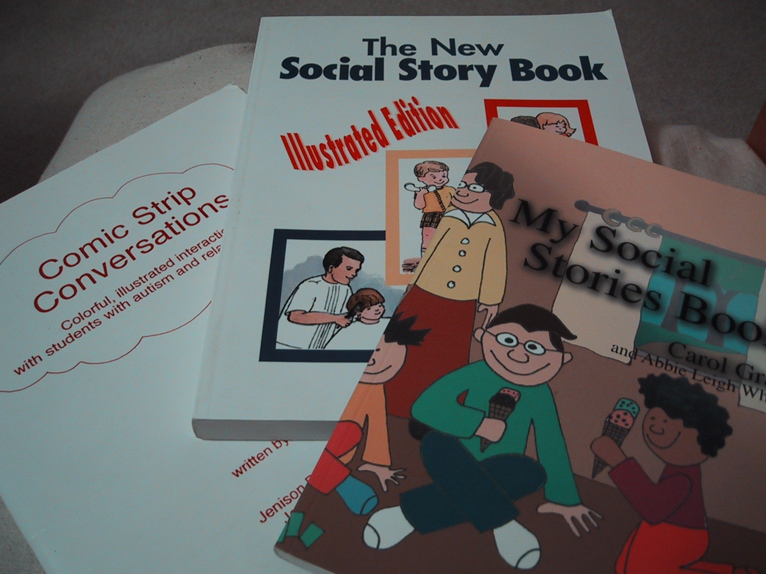

Slide 21
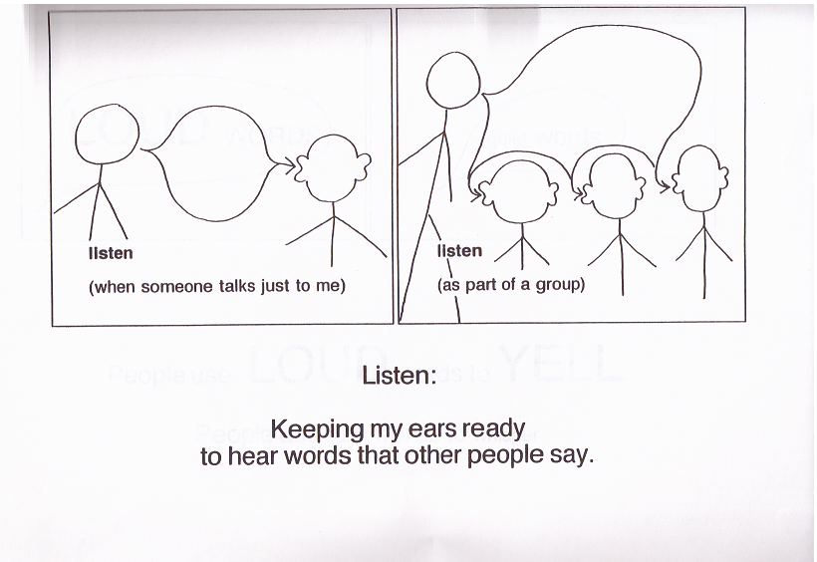

Slide 22
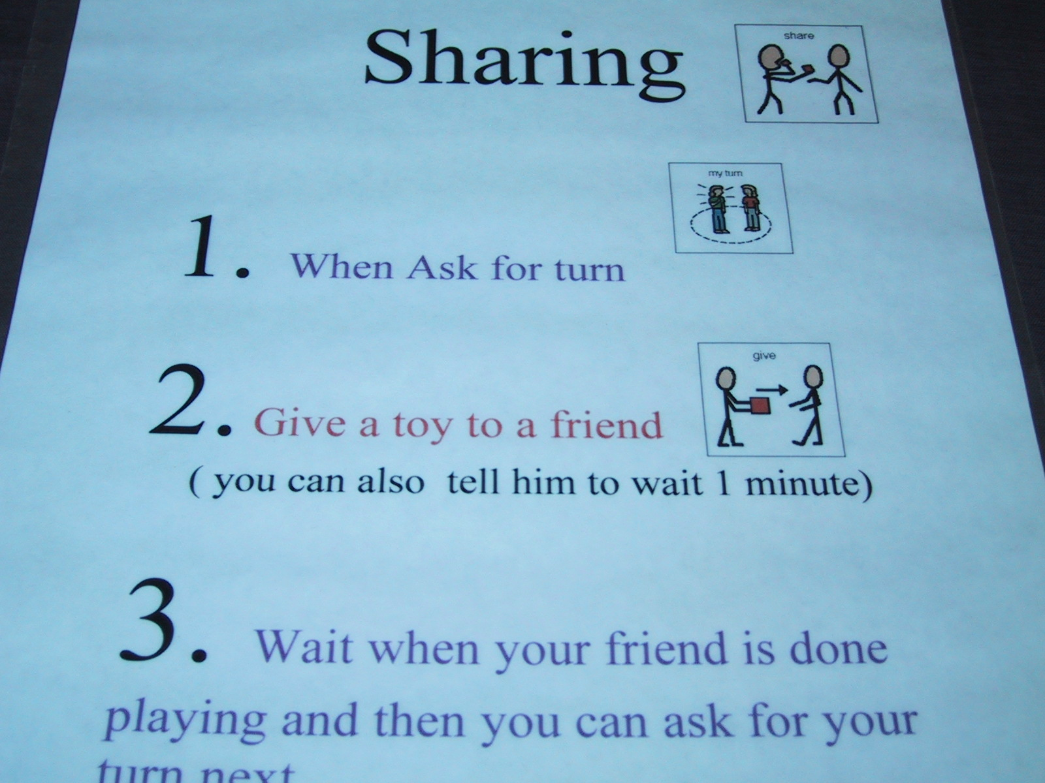

Slide 24
Visual Based Strategies: Conversation Starters/Scripts
What are they?
Cues for conversations
How to use them?
Develop cue
Implement with student

Slide 25
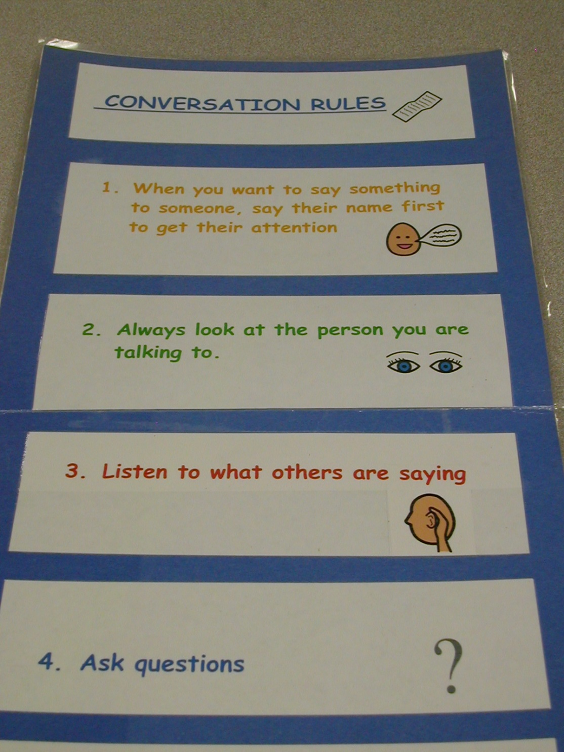

Slide 26
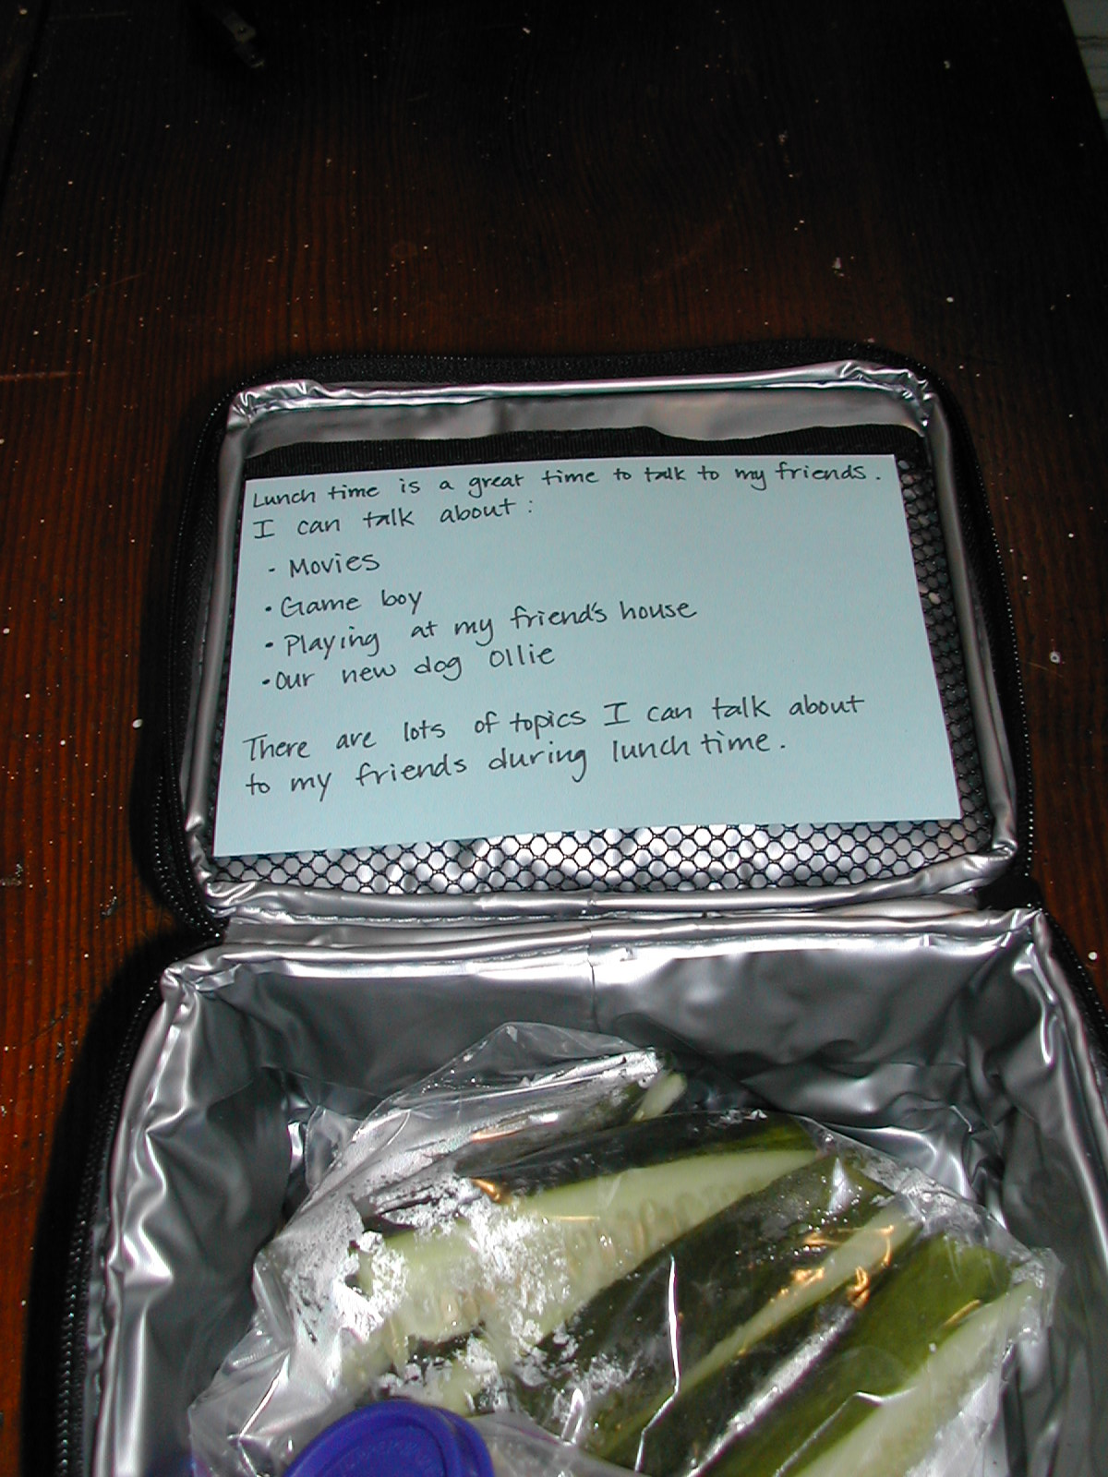

Slide 27
Social Integration Strategies: Why are they useful for teaching social skills?
Develop social competence
Opportunity to interact with peers in a positive manner

Slide 28
Social Integration Activities: Stay, Play and Talk
What are they?
Teaches students to engage with peers
How to use them?
Develop cue
Structure activity

Slide 29
STAY: with the group
at the table
during math game
PlAY: math game
with friends
TALK: with friends
ask questions

Slide 30
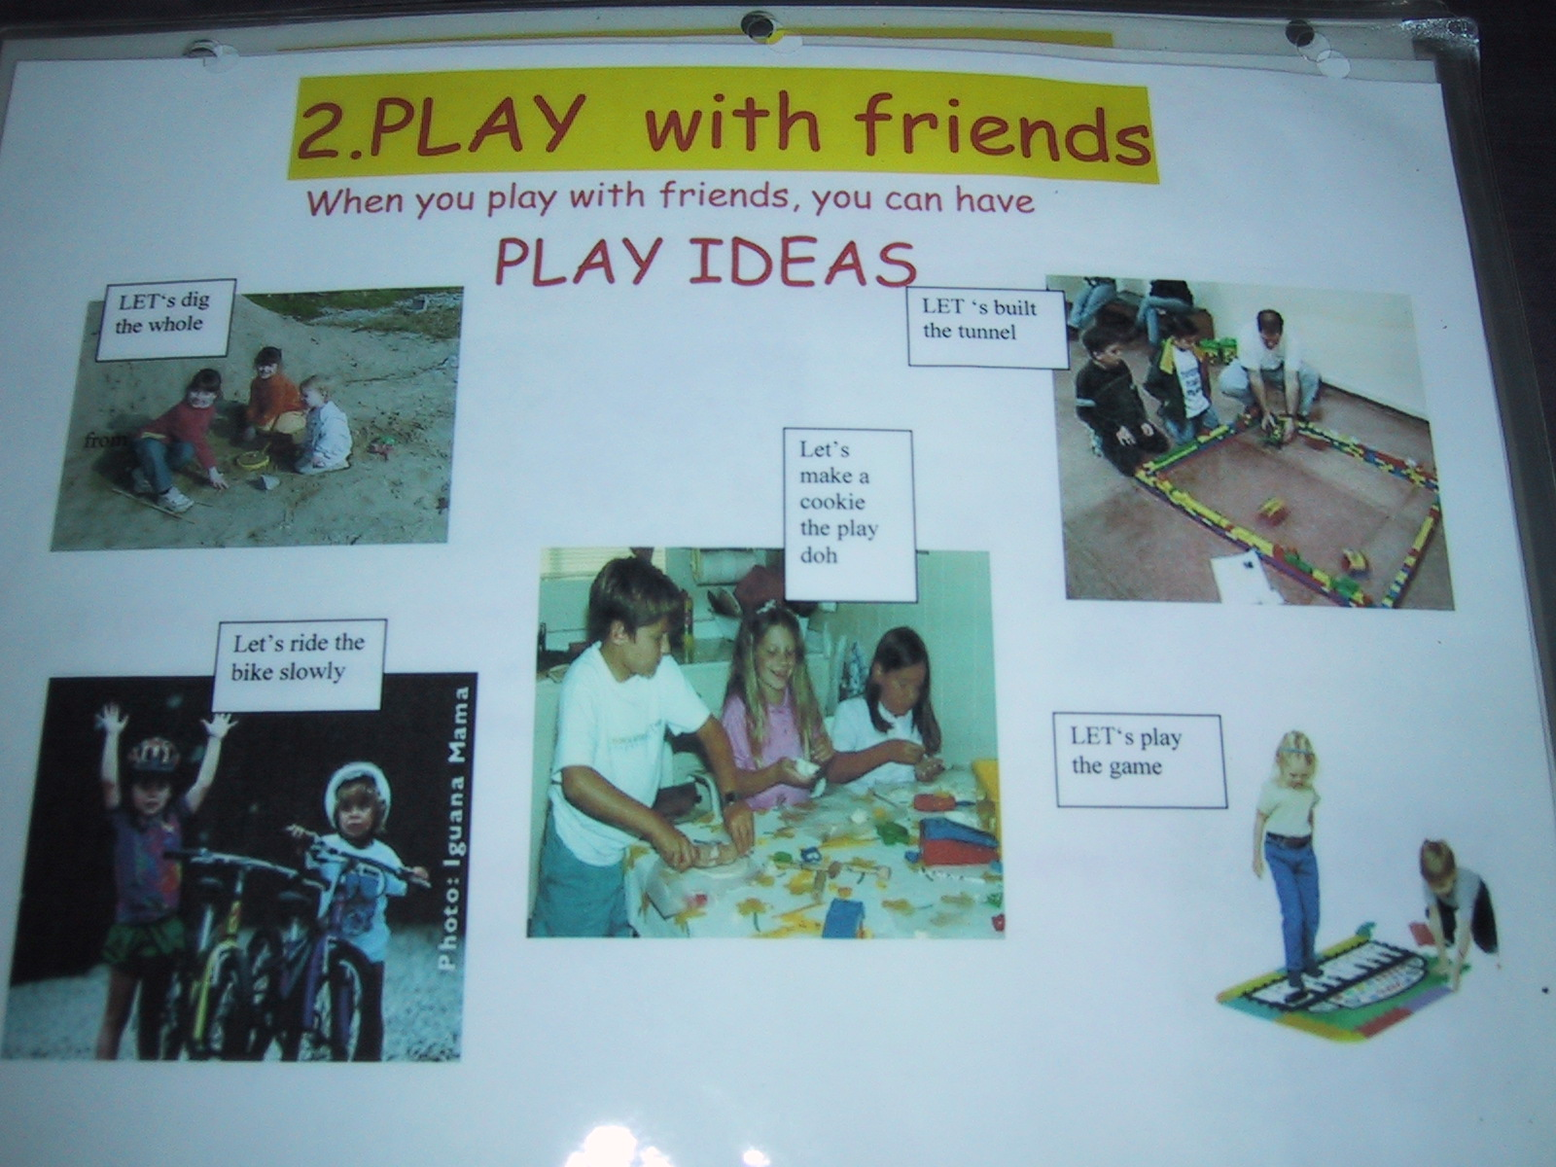

Slide 31
Social Integration Activities: Buddy Day Activities
What are they?
Peers work together
How to use them?
Select buddies
Select activities

Slide 32
